Slide 1
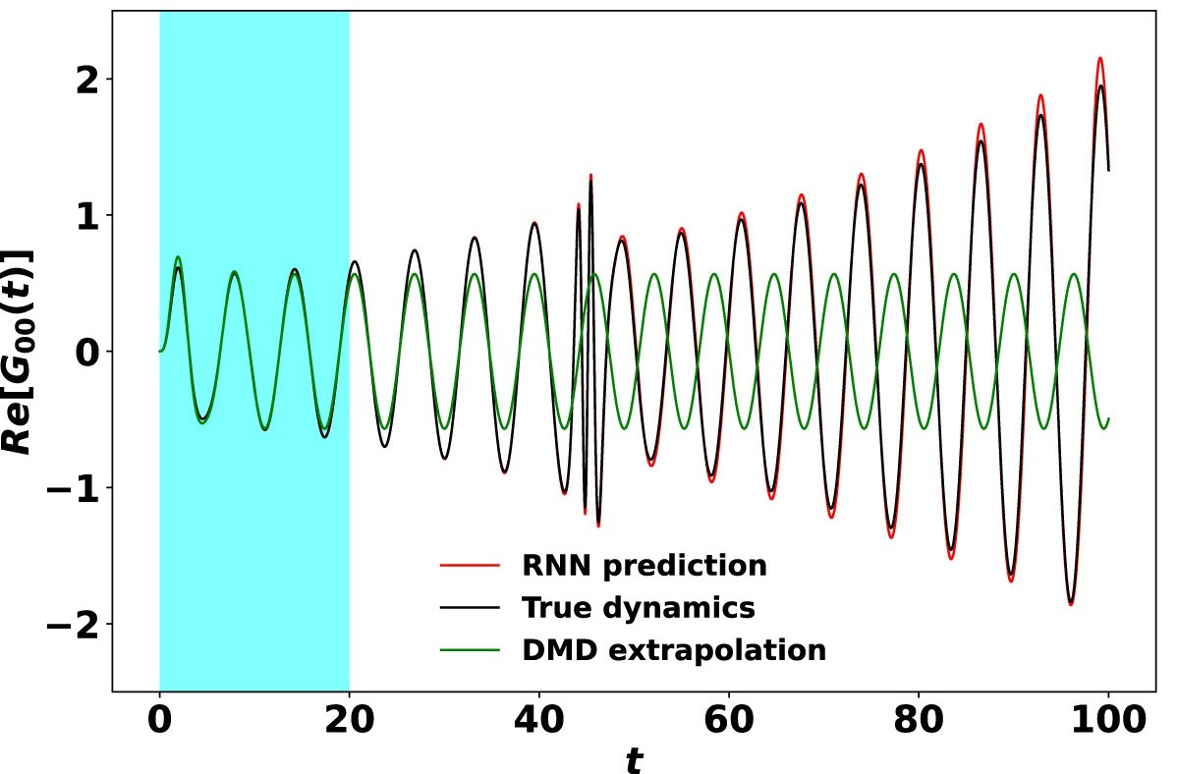
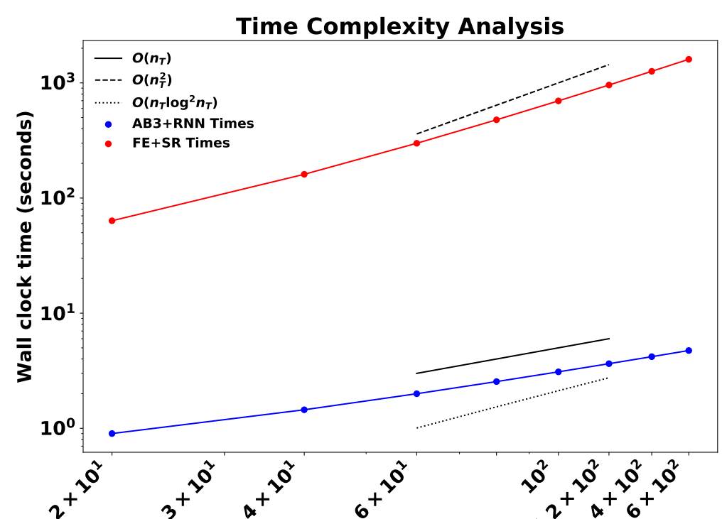
Nonlinear Integral Operator Learning via Recurrent Neural Network and Its Application to Solving Integro-differential Equations C. Yang (LBNL) and V. Vlcek (UCSB)
Scientific Achievement
Developed a methodology to use LSTM-RNNs (Long Short-Term Memory Recurrent Neural Networks) to learn and represent nonlinear integral operators in nonlinear integro-differential equations (IDEs) so that IDEs can be solved efficiently as ordinary differential equations (ODE).
Significance and Impact
Significantly reduce the computational cost of solving nonlinear IDEs arising from the modeling and simulation of non-equilibrium electronic phenonmena in quantum materials.
Research Details
Construct an LSTM-RNN to learn the integral term in $\frac{dG(t)}{dt}=F\left(G\left(t\right),t\right)+\int_{0}^{t}{K\left(G\left(t−s\right),s\right)G\left(s\right)ds}$ because the mapping is independent of $G(t)$, and can be easier to learn than $G(t)$ itself.
Once the integral operator is learned, we can use it in an ODE solver to solve the IDE.
Use a single trajectory or multiple trajectories (associated with different time-dependent driving fields) within a short time window to train RNN
RNN architecture
The RNN based solver (AB3+RNN) is more effective than DMD in extrapolating long time dynamics (left). It is more efficient than a standard IDE solver (FE+SR).
H. Bassi, Y. Zhu, C. Reeves, S. Liang, J. Yin , V. Vlcek and C. Yang, “Learning nonlinear integral operators via recurrent neural networks and its application in solving integro-differential equations”, Journal of Machine Learning with Applications, 15, 2024. doi:10.1016/j.mlwa.2023.100524
Notes:
This work results from successful collaboration between ASCR and BES researchers in the BES SciDAC partnership project title “Real-time dynamics of driven correlated electrons in quantum materials”
It is motivated by need to reduce the computational cost of solving the Kadanoff-Baym equation (KBE) which is a set of nonlinear integro-differential equations (IDEs) satisfied by the two-time Green’s function that can be used to describe the excitation process of a quantum many-body system out of equilibrium.
The key bottleneck in solving the KBE is the evaluation of the integral term in each numerical time evolution step, which leads to O(t^3) time complexity. For a one-time integro-differential equation, the time complexity is O(t^2).
The method we developed uses a type of recurrent neural network (RNN) called LSTM (long short term memory) to learn and represent the integral term. Once properly trained, the RNN representation of the integral can be evaluated quickly so that we can effectively reduce the IDEs to ODEs that can be solved efficiently by existing ODE solvers. This can reduce the time complexity to O(t^2) for two-time Green’s functions and O(t) for one-time Green’s function.
Although it may be possible to use neural networks to learn the Green’s function directly, we believe it is easier and better to learn the integral operator. The main reason is that the integral operator itself is independent of the solution of the KBEs. In particular, it is independent of the external driving field. Once properly trained, it can successfully predict dynamics of the Green’s function outside of the training time window. This makes this RNN nonlinear integral operator learning based approach superior to the dynamic mode decomposition (DMD) based approach (which we developed in the past) for extrapolating the dynamics of the Green’s function.
The top figure on the right shows the basic architecture of the RNN. The input of the RNN is the values of the Green’s function on a set of uniformly partitioned time grid, obtained by solving the IDE within a small time window. The output of the RNN is the evaluated of integral term in the IDE. The left part of the network is trained. The right part shows how the RNN is used to extrapolate the integral term to future time locations.
The bottom figure shows that the RNN based approach works well for a model IDE problem:
$$\frac{dG(t)}{dt}=A\left(t\right)G\left(t\right)+\int_{0}^{t}{K\left(t−s\right)G\left(s\right)ds}$$
where $A\left(t\right)=−i\left[\begin{matrix}−βe^{\frac{−{\left(t−α_{1}\right)}^{2}}{σ}} & 1 \\ 1 & βe^{\frac{−{\left(t−α_{1}\right)}^{2}}{σ}}\end{matrix}\right]$, $K\left(t\right)=\left[\frac{G^{2}(t)}{4}\right],$ $G\left(0\right)=\left[\begin{matrix}i & 0 \\ 0 & i\end{matrix}\right]$
In particular, it shows that even when the external field includes a sudden kick outside of the time window in which the KBE is solved (and the training data set is collected), the RNN based solver can successfully predict the long time dynamics whereas the DMD based approach fails (because it only sees well behaved dynamics within the training time window.)
The bottlom right figure shows that the RNN based solver which uses the RNN representation of the nonlinear operator to reduce an IDE to an ODE is more efficient. In the RNN based approach, the ODE is solved by a 3rd order Adams-Bashforth method. We compare the performance of the RNN based solver with that of a standard IDE solver in which a first order Euler (FE) method is used to time evolve G and a second order Simpson’s Rule (SR) is used to evaluate the integral term. We can see that the time it takes the RNN to solve the problem is two orders of magnitude smaller than that required by a standard IDE solver. The computational cost of the RNN based approach scale linearly with respect to time, where as the standard IDE solver scales quadratically with respect to time.

