Slide 1
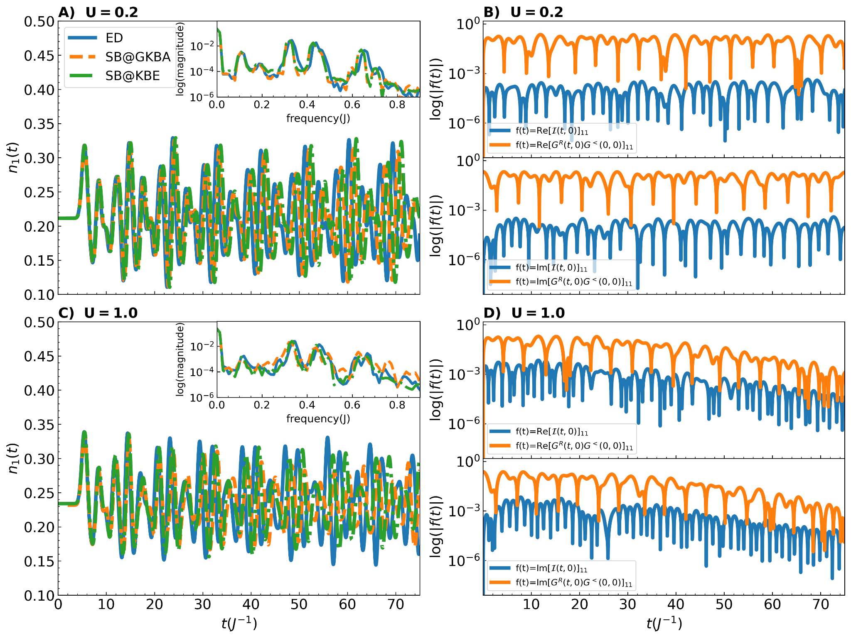
Partial neglect of system memory without loss of accuracy
\
V. Vlcek (UCSB), C. Yang (LBNL)
Scientific Achievement
We proved rigorously that the memory terms neglected in the GKBA are bound by a function of the interaction strength and orbital density. We tested our arguments numerically in a set of realistic lattice models under different non-equilibrium preparations, showing broadly that the neglected terms are often orders of magnitude smaller than those retained. We found the quality of results given by the Kadanoff-Baym equations breaks down before negative effects of GKBA approximations kick in. Further, we showed that away from half filling the neglected terms results in little difference between the GKBA and KBE(quarter filling; left).
Significance and Impact
Arguments and numerical evidence showed that the GKBA delivers essentially the same results as the KBE at much lower cost. Can confidently use the GKBA in cases where the full KBEs would be expected to work. Mathematical and numerical analysis help build picture of where failures in both methods can be expected.
Research Details
Comparison of GKBA and KBE with a variety of realistic lattice models, non-equilibrium conditions, filling factors and couplings.
Rigorous numerical bound on neglected terms in GKBA, justifying use of GKBA over KBE.
GKBA and KBE show good agreement up until KBEs begin to fail, in which case neither method will give accurate results
Left: Comparison of KBE, GKBA and exact time dependent density on first site of 8-site lattice model with long range interactions and hopping at quarter filling after excitation with short wavelength pulse. Right: Comparing terms neglected(blue) to terms that are retained(orange) in the GKBA.
C. Reeves, Y. Zhu, C. Yang and V. Vlcek, “Unimportance of memory for the time nonlocal components of the Kadanoff-Baym equations”, Phys. Rev. B 108, 115152 – Published 25 September 2023

