Slide 1
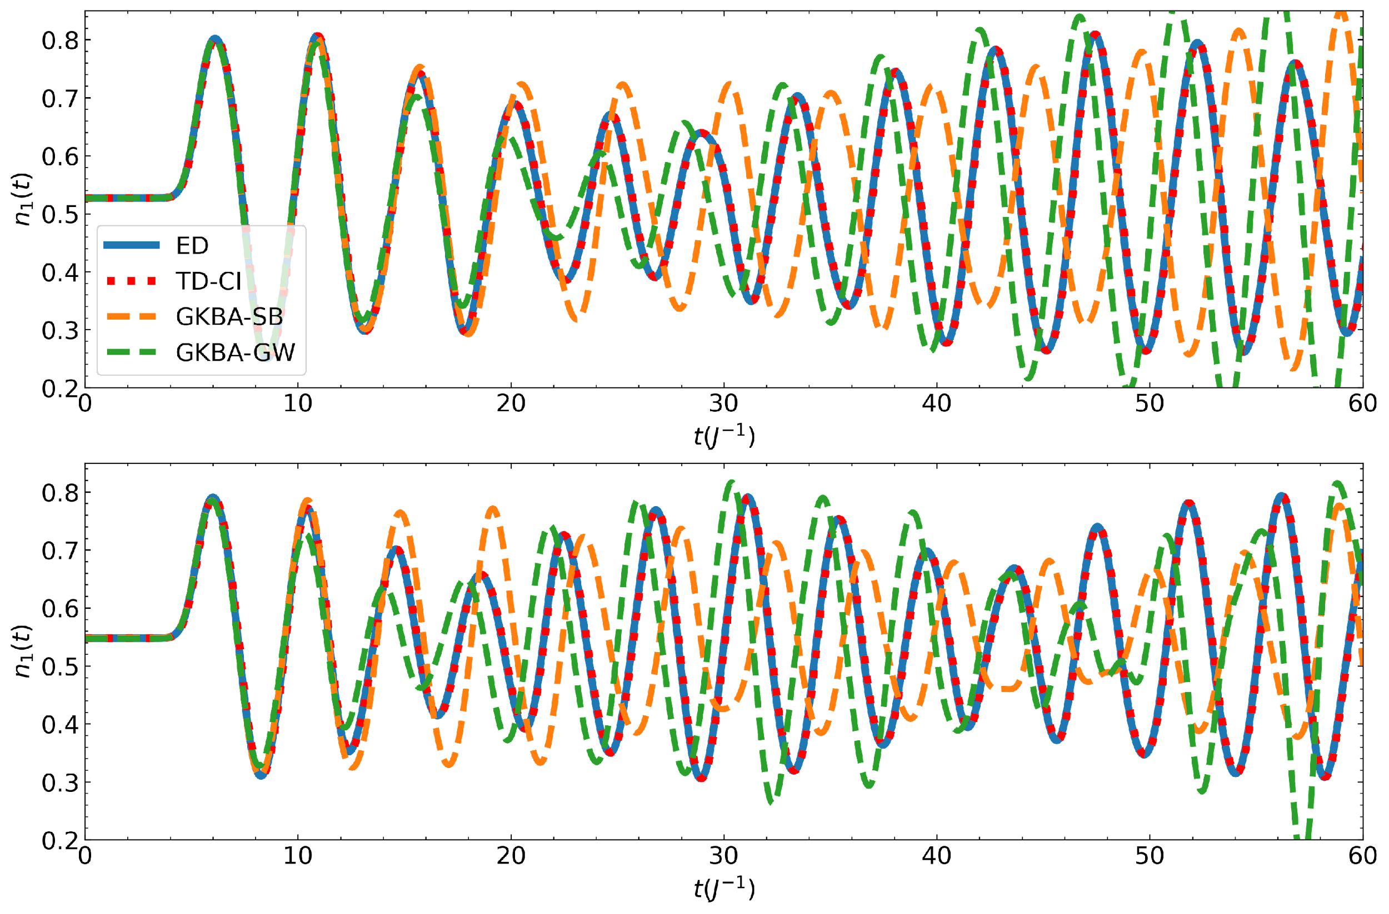
Accuracy of time dependent methods in large systems
V. Vlcek (UCSB), L. Lin (UCB/LBNL), C. Yang (LBNL), B. Whaley (UCB), and D. Zgid (UM)
Scientific Achievement
We showed that compressed Krylov subspace TD-CI reproduces exact calculations enabling accurate treatment of systems over 100% larger than possible before. The Green's function methods (GKBA) generally perform well and are systematically improved by self-energy formulation, from second Born to GW approximation (SB and GW). Yet, we mapped the conditions when optical pulses generate complex dynamics even in weakly correlated systems (U= 0.5; left) leading to incorrect GKBA dynamics.
Significance and Impact
Extended capabilities to exactly study many-body quantum systems by over 100% in the system size. New ability for testing accuracy of other method’s with increasing system size which is important for application of methods to extended periodic systems. Benchmarks will help inform improved formulation of diagrammatic methods.
Time dependent density on first site of an extended Hubbard model with long range Coulomb interactions. The system is prepared in a correlated ground state before dynamics are induced by an ultrafast optical pulse. TD-CI faithfully captures the exact dynamics (ED) but GKBA fails for these conditions despite the relatively weak interaction strength(top U=0.5); the use of the more advanced GW self-energy approximation leads to better dynamics at the various U parameters. Top U=0.5, Bottom U=1.0
Research Details
Comparison of ED and Green's function dynamics with a variety of realistic lattice models and non-equilibrium conditions
Demonstrate the ability TD-CI to reproduce ED results with high fidelity even in strongly correlated systems.
Diagrammatic methods show good agreement for systems which are well captured at equilibrium (i.e., up to strongly interacting regime)
Notes:
BES Highlight
Developed time dependent CI methods for exact time evolution of intermediate scale systems
Explored systematic improvements to self-energy approximations, pushing accuracy of Green’s function based methods to higher interaction strengths
Find system can be driven to regimes where interactions are weak enough for equilibrium MBPT to work well but driving induced correlations give rise to incorrect dynamics from GKBA
Exploring extension of self-energy improvement in the context of improving the propagation of NEGFs

