Slide 1
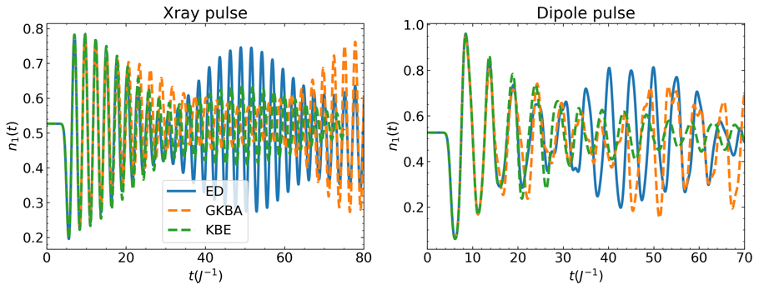
Efficient Approximate Solution of Non-Equilibrium Green’s Function C. Yang (LBNL), L. Lin (UCB/LBNL), K. Ibrahim (LBNL), and V. Vlcek (UCSB)
Scientific Achievement
We mapped the quality of Generalized Kadanoff-Baym Ansatz (GKBA) - an approximate scheme for computing non-equilibrium Green’s functions (NEGFs) for a quantum many-body system. The approximation neglects quantum memory effects which are induced by strong short wavelength pulses and drive the system to the strongly correlated limit.
Significance and Impact
The detailed mapping uncovered the limitations of memory-less NEGF evolution approximations. GKBA is still widely applicable, since for strong interactions, the diagrammatic approximations fail regardless of memory effects. The inclusion of memory leads to limited improvement in only a narrow range of conditions. We thus mapped the numerical accuracy of NEGF propagation for applications in realistic systems.
Top: Comparison of time dependent density for the GKBA, exact dynamics and KBE for system driven from equilibrium with different ultrafast pulses. Bottom: comparing magnitude and decay for time off-diagonal components of self energy and Green’s function. Quality of GKBA compared to KBE depends on magnitude of self energy compared to Green’s function, hence in many cases with moderate correlations we see only marginal improvement of GKBA results by KBE with a large increase in computational cost.
Research Details
Performed comparative studies of GKBA and full KBE in computing NEGFs for exactly solvable lattice models.
Investigated the connection between the error of GKBA approximation, the Green’s function and self energy decay properties for systems with different interaction strength and external fields.
C. Reeves, Y. Zhu, K. Ibrahim, C. Yang and V. Vlcek, “Memory build up in the time evolution of non-equilibrium Green's functions and the limits of Generalized Kadanoff-Baym ansatz”, in preparation
Notes:
Poor numerical scaling of the full KBE(O(N^3)) compared to GKBA (O(N)) makes GKBA a desirable approximation scheme
Investigate regimes under which KBE and GKBA give significantly different results
Find GKBA and KBE perform similarly in regimes where MBPT is effective theory in equilibrium(weak to moderate interaction strengths)
Investigate link between self energy magnitude/decay properties and the quality of the approximations that lead to GKBA.
See that terms that are dropped in making GKBA are generally small in regimes where KBE works. Conversely, generally when approximate terms are large we are already out of the range of applicability of the full KBE

