Slide 1
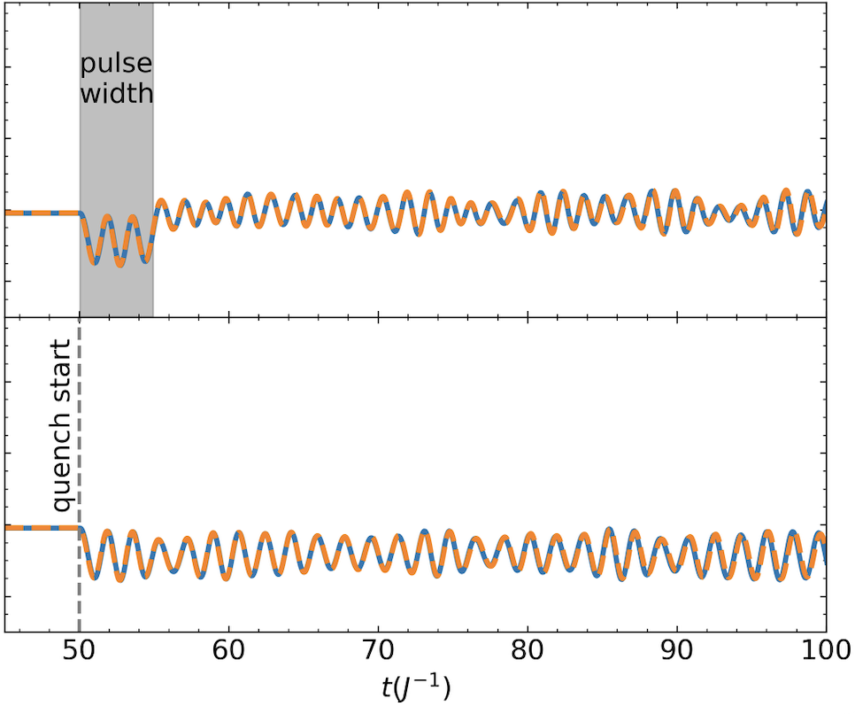
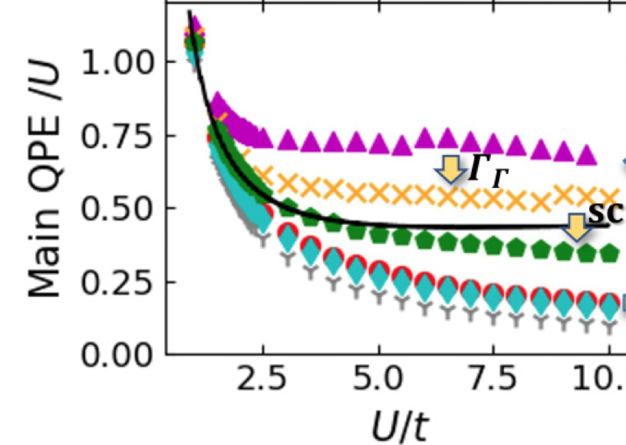
Tractable Theory and Simulation of Non-equilibrium systems
V. Vlcek (UCSB), L. Lin (UCB/LBNL), C. Yang (LBNL), and B. Whaley (UCB)
Scientific Achievement
Demonstrated accuracy of GKBA for long range interacting many-body Hamiltonians, with ability for systematic improvement for strong interactions. First publicly available code for linear time scaling evolution of NEGFs in realistic many-body quantum systems.
Significance and Impact
Demonstrated tractable many-body perturbation theory(MBPT) framework for practical simulations of non-equilibrium electronic phenomena in quantum materials and ultrafast processes observed in photoemission and optical spectroscopy.
Dipole trajectory obtained from exact time evolution(blue) and GKBA(orange) for long range interacting Hamiltonian.Inset: Systematic improvement of MBPT spectral functions: GWΓ (green pentagons) and exact result (black line).
Research Details
Benchmarking the many-body dynamics with exact time propagation, selected CI methods and GKBA.
Practical self-energy approximations capture well the many-body dynamics of long range interacting Hamiltonians
Explicit two-body interactions in the self-energy are being explored for non-equilibrium of strongly correlated systems
C. Mejuto Zaera, V. Vlcek, "Self-consistency in GWΓ formalism leading to quasiparticle-quasiparticle couplings". Phys. Rev. B 10.1103/PhysRevB.106.165129 (2022)
C. Reeves, J. Yin, Y. Zhu, K. Ibrahim, C. Yang and V. Vlcek, “Extrapolation of Hartree-Fock GKBA Trajectories with Dynamic Mode Decomposition" https://doi.org/10.48550/arXiv.2211.05868 (2022)
Notes:
BES Highlight
We developed a linear time-scaling code for the preparation and propagation of NEGFs in quantum many-body systems
We focused on benchmarking GKBA on realistic Hamiltonians with long range interactions.
Discovered significant improvements of GKBA in systems with long range interactions
Developed time dependent CI methods for exact time evolution of intermediate scale systems
Explored systematic improvements to self-energy approximations, pushing accuracy of Green’s function based methods to higher interaction strengths
Exploring extension of self-energy improvement in the context of improving the propagation of NEGFs

