Slide 1
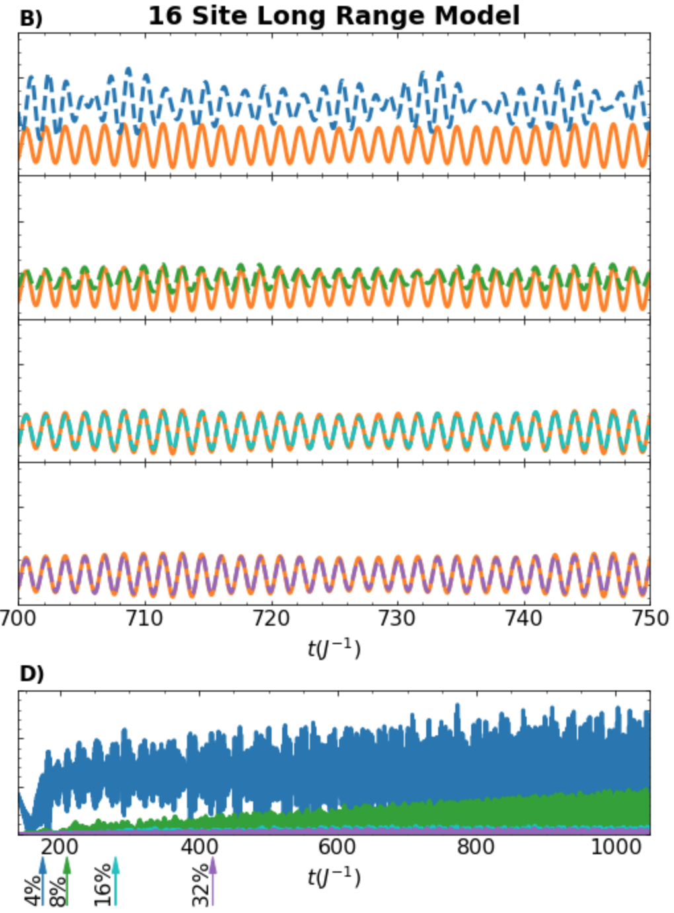
Numerical Extrapolation of Non-Equilibrium Quantum Dynamics
C. Yang (LBNL), L. Lin (UCB/LBNL), K. Ibrahim (LBNL), and V. Vlcek (UCSB)
Scientific Achievement
We developed efficient and scalable numerical approximations for long time evolution of non-equilibrium Green’s functions (NEGFs) in large many-body systems.
A comparison of the dipole fluctuation computed from the Dynamical Mode Decomposition extrapolation of all the NEGF trajectory components. Long range interacting many-body Hamiltonian is studied here; from top to bottom: DMD fit is based on 4, 8, 16, and 32% of the trajectory. Residual is shown at the bottom
Significance and Impact
Enabling SciDAC partnership scientists to study large scale many-body systems:increasing simulation trajectories by orders of magnitude compared to state of the art without loss of fidelity or compromising numerical stability.
Research Details
Efficient and robust Dynamical Mode Decomposition(DMD) NEGFs trajectory extrapolation for Hamiltonians with long-range interactions
Parallelized a generalized Kadanoff-Baym Ansatz (GKBA) solver and optimized its performance
Investigated the Mori-Zwanzig formulation of the NEGFs
Investigated the possibility of using transformer based neural network to predict long time dynamics of NEGFs
C. Reeves, J. Yin, Y. Zhu, K. Ibrahim, C. Yang and V. Vlcek, “Extrapolation of Hartree-Fock GKBA Trajectories with Dynamic Mode Decomposition" https://doi.org/10.48550/arXiv.2211.05868 (2022)
Y. Zhu, "Combinatorial Mori-Zwanzig Theory", https://doi.org/10.48550/arxiv.2210.08395, (2022)
Notes:
ASCR Highlight
We focused on developing efficient numerical methods for computing non-equilibrium Green’s function by solving Kadanoff-Baym’s equations.
The full KBE solver scales cubically with respect to time.
We followed the recent development of GKBA and G1-G2 approach to reduce the computational complexity to O(t^2) or O(t).
We investigated the regime in which GKBA/G1-G2 approach gives accurate approximation
We also combined GKBA with DMD to further reduce the computational cost by constructing a reduced model within a small time window and use the reduced model to extrapolate for large t.
We worked on parallelizing the GKBA solver and improving its performance on NERSC.

