Slide 1
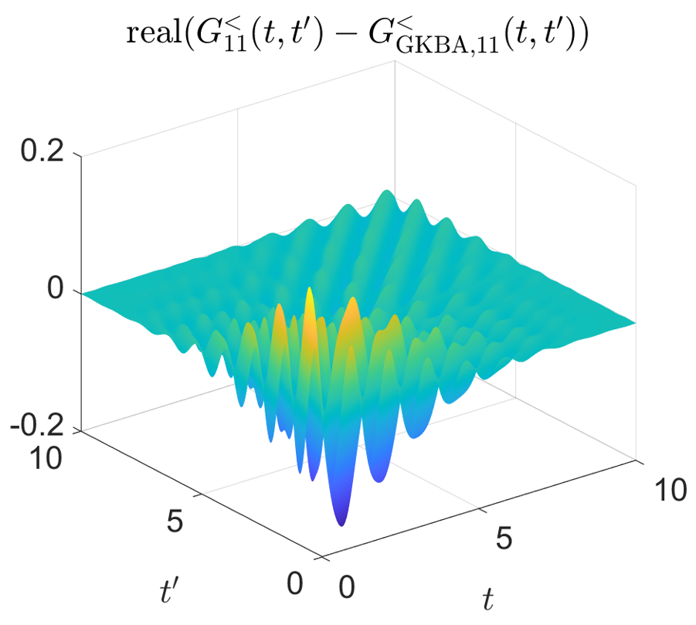
Analyze Generalized Kadanoff-Baym Ansatz Jia Yin, Yuanran Zhu, Chao Yang (LBNL) Cian Reeves and Vojtech Vlcek (UCSB)
Scientific Achievement
We analyzed the accuracy of the Generalized Kadanoff-Baym Ansatz (GKBA) for approximating non-equilibrium Green’s function by performing one-time dynamics and identified the applicability and limitation of this approach
Significance and Impact
This analysis will allow us to apply GKBA for problems in which such an approximation is valid to reduce the computational complexity to $O(N_{t}^{2})$ from $O(N_{t}^{3})$
Research Details
The GKBA approximation only require performing one-time evolution, therefore has a lower computational complexity with respect to time.
However, it is based on the assumption that a double time integral with both Green’s function and approximate self-energy in the integrand is small.
Our numerical experiments indicate that this integral is generally not small. Only under certain conditions, it is reasonable to drop these integrals
The real part of the lesser Green’s function is significantly different from the GKBA approximation for a Hubbard dimer driven by an instantaneous pulse with a modest intensity
Notes:
We successfully used the DMD method to predict electron occupations from the solution of a real-time Boltzmann equation (computed by the PERTURBO software) within a small time-window. The top figure shows the DMD extrapolated trajectory of electron occupation at a particular k-point (k=17397) matches well with the numerical solution of the real-time Boltzmann equation computed by the PERTURBO software. The bottom figure shows the extrapolated electron occupations at all k-points at t=2x10⁴ match well with those obtained from the solution of the Boltzmann equation. Because the Boltzmann equation becomes progressively more costly to solve as t increases (due to the collision integral term), the DMD based approach is orders of magnitude more efficient.

