Slide 1
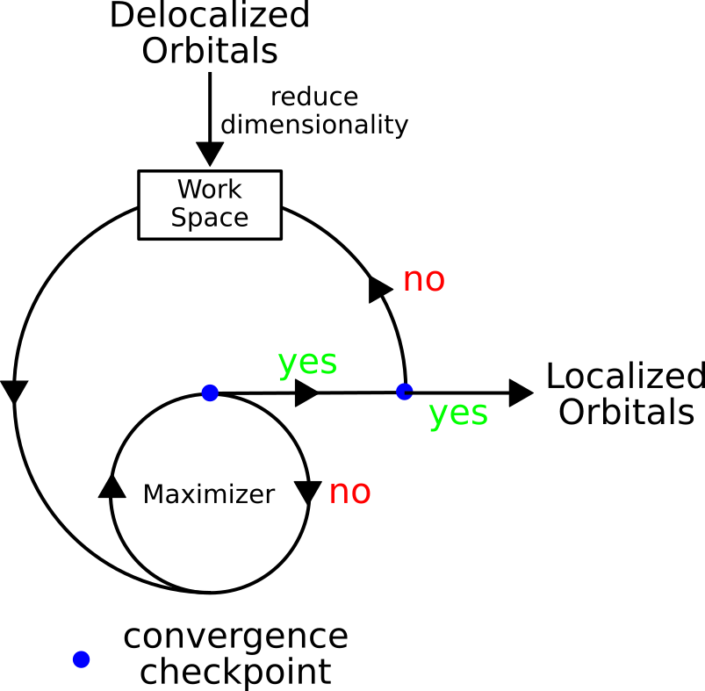
Regional Wannier Functions in Giant Systems
Scientific Achievement
We present an efficient and robust linear scaling algorithm to uniquely obtain optimally localized electronic basis in realistic nanoscale systems.
c
Significance and Impact
Optimal localized representation of the correlated electronic subspace is critical for electronic embedding and downfolding. We overcome the limitations of the previously available techniques and provide a linear-scaling algorithm that can be applied to giant systems with tens of thousands of electrons. The method is readily applicable even if the individual electronic states are unknown (e.g., in stochastic calculations).
Schematic illustration of the sequential localization algorithm featuring a nested-loop structure. The input orbitals are delocalized canonical states that are transformed into localized states on selected atoms.
Research Details
Sequentially exhaustive search over single-particle space yields optimally localized Wannier basis for excited-state calculations exemplified on NV- centers
G. Weng, M. Romanova, A. Apelian, H. Song, V, Vlcek, arXiv:2204.00252v1
Notes:
Localizing electronic states is a necessary prerequisite for an effective and efficient embedding procedure: the optimally localized basis minimizes the size of the explicitly correlated subspace and simplifies the Hamiltonian representation. One of the main bottlenecks in searching for optimally localized orbitals within a large system is the necessity to treat all electronic states simultaneously. We devise a simple but efficient and robust technique that iteratively searches through the electronic states with significantly reduced cost and scaling (which remains linear in practice). Further, we show that the optimally localized representation for a quantum defect is achieved only through a search over the various regions of the space – global optimization (i.e., localization on all atoms in the system) yields suboptimal results which significantly affect the accuracy of the predictions. The method enables a swift and reproducible step for embedding explicitly correlated methodologies in many-body perturbation techniques.
Publication/ press releases/ related links
https://arxiv.org/abs/2204.00252

