Slide 1
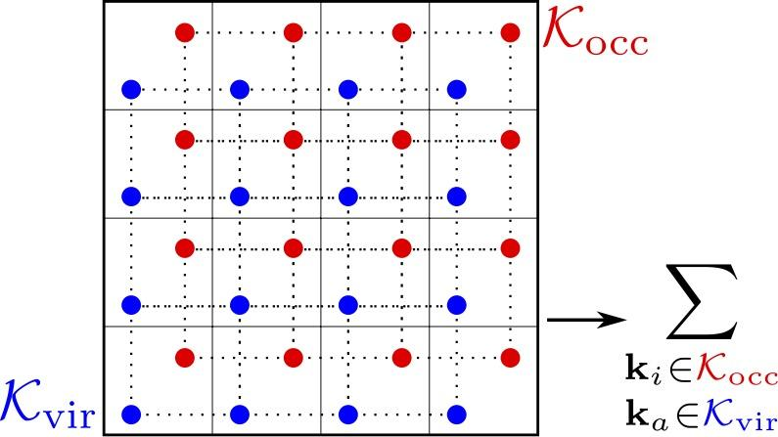
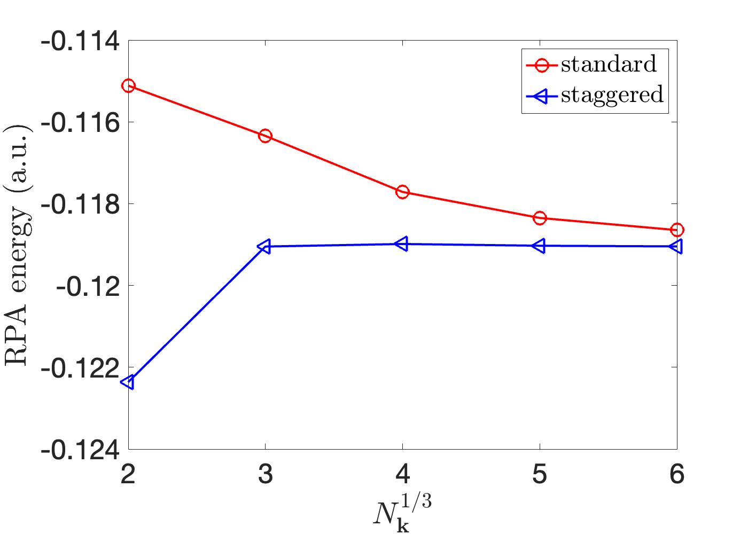
Analysis and correction of the finite size error in energy calculations for periodic systems
Scientific Achievement
We provide a rigorous mathematical analysis of the finite size errors in Hartree-Fock exchange, MP2 and RPA energy calculations for periodic systems, and propose an effective finite size correction method based on the analysis.
c
Significance and Impact
Finite size errors in electronic structure theories for periodic systems often remain poorly understood. We provide the first rigorous convergence rate analysis of the errors in the periodic calculations with non-local electron electron interactions. The staggered mesh method removes a significant portion of the errors, resulting asymptotically faster error decaying all quasi-1D systems and certain quasi-2D and high-symmetry 3D systems.
Staggered quadrature meshes
Comparison on 3D diamond RPA calculation
Research Details
Interpret the HF, MP2, RPA calculations as multidimensional integral discretized with certain trapezoidal quadrature rule.
X. Xing and L. Lin, JCTC, 18, 2 763-775, 2022
Notes:
Despite decades of practice, finite size errors in many widely used electronic structure theories for periodic systems remain poorly understood. We provide the first rigorous convergence rate analysis of the finite size errors in the periodic Hartree-Fock (HF), second order Moller-Plesset (MP2), and random phase approximation (RPA) theories, respectively. This analysis pinpoints the main error sources and gives guidance for developing effective finite size correction schemes. We propose the staggered mesh method for HF, MP2, and RPA energy calculations that removes a significant portion of the finite size errors due to zero momentum transfer. This correction scheme is especially effective for all quasi-1D systems and certain quasi-2D and 3D systems with high symmetry, resulting asymptotically faster error decaying.
Further, we provide a unified analysis of the quadrature errors for periodic but singular integrand functions defined in HF, MP2, RPA calculations and propose a new trapezoidal rule that avoids significant quadrature errors at singular points in these energy calculations.
Publication/ press releases/ related links
X. Xing and L. Lin, JCTC, 18, 2 763-775, 2022

